Slide 1



The Data Immersed
TDI
2025
PowerBI Capstone Presentation
Hospital Records Analysis : Healthcare Utilization and Cost Insights
Driving Efficiency, Financial Performance, and Policy Support

Slide 2
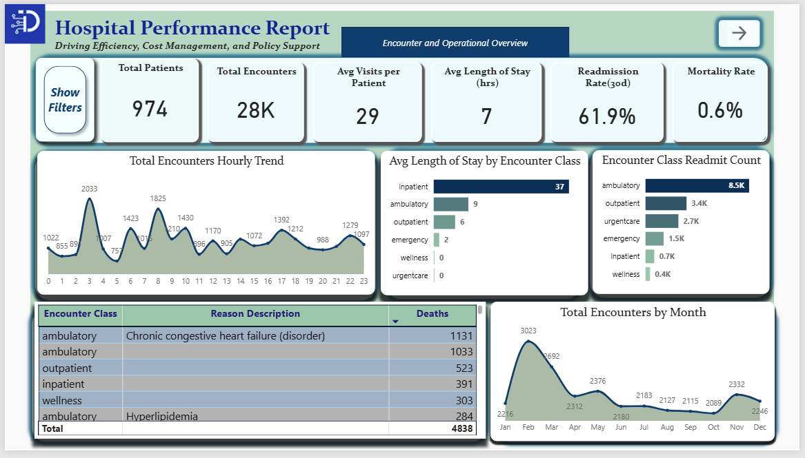

Slide 3
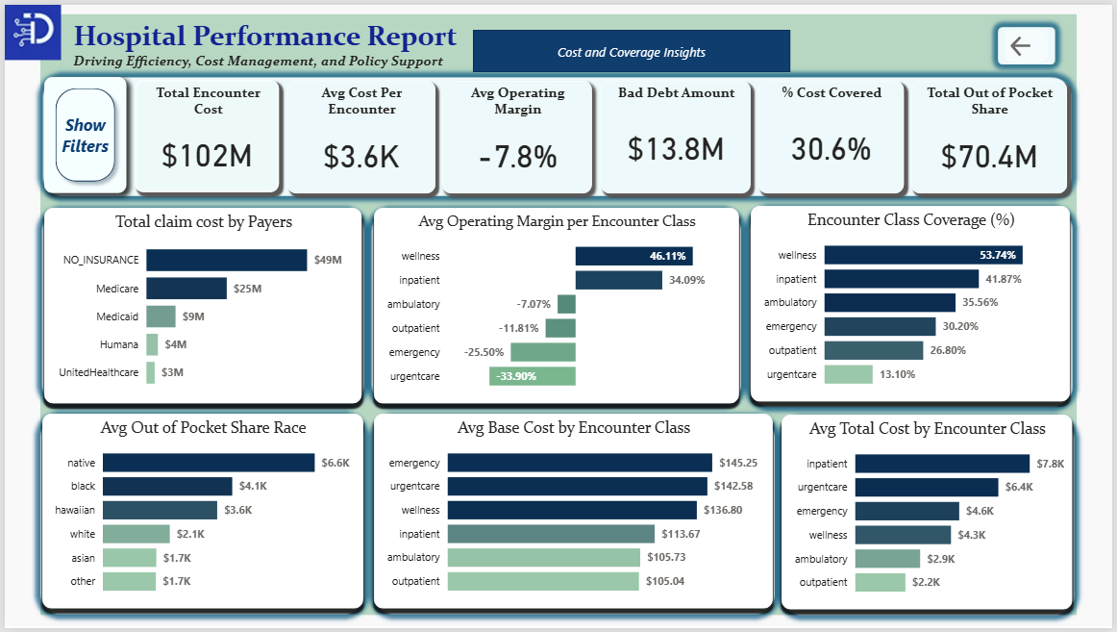

Slide 4
OVERVIEW
This project explores synthetic patient data (~1,000 records) from Massachusetts General Hospital spanning 2011–2022. The dataset captures demographics, insurance coverage, medical encounters, and procedures.
It explores how patient and insurance factors influence healthcare use and hospital performance.
While the data is synthetic, the insights mirror real-world challenges in balancing quality care with financial sustainability. Early findings point to areas where efficiency, patient equity, and financial performance intersect—key levers for both healthcare providers and policymakers.

Slide 5

PROBLEM STATEMENT
How can hospitals improve efficiency, expand access to healthcare while maintaining financial sustainability?

Slide 6

Why This Case Is Relevant
BACKGROUND
Help policymakers design stronger insurance frameworks and resource allocation strategies.
Enable hospital directors to streamline operations, improve patient outcomes, and manage costs more effectively.
Provide investors with a clearer picture of hospital performance, sustainability, and return on investment.
The healthcare industry is under mounting pressure to deliver high-quality care while controlling costs and meeting the needs of diverse populations. Hospitals, as the core of this system, face an evolving set of challenges shaped by financial pressures, operational inefficiencies, and demographic shifts.

Slide 7




GOAL
The goal of this study is to leverage hospital encounter data to generate insights that improve healthcare utilization, financial performance, and operational efficiency.
Success will be defined by the ability to transform raw hospital records into actionable insights that help patients receive better care, directors manage resources effectively, and policymakers design stronger healthcare frameworks

Slide 8
OBJECTIVES
1. Analyze encounter data to identify trends in utilization, costs, and claim coverage.
2. Measure key hospital metrics such as mortality rate, readmission rate, and average length of stay.
3. Compare base costs and total claim costs across encounter classes and payers.
4. Detect inefficiencies, including encounters with zero coverage or unusually long durations.
5. Provide dashboards that summarize KPIs for policymakers, hospital directors, and investors.

Slide 9
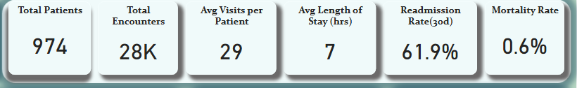
KEY PERFORMANCE INDICATORS
• Total Patients : Unique individuals served.
• Total encounters : All recorded visits or admissions
• Average visits per patient : Encounters per unique patient.
• Average length of stay(hrs.): Mean time patients spend in care.
• Readmission rate : % of patients returning within 30 days
• Mortality rate : % of patients who died during encounters.

Slide 10
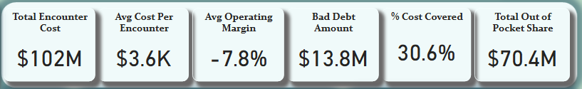
KEY PERFORMANCE INDICATORS
• Total Encounter Cost : Total hospital spending on all patient encounters.
• Average cost per encounter : Mean cost per patient visit.
• Average operating margin : % of profit retained after operating costs.
• Bad Debt Amount : Unpaid costs from insurers.
• % cost covered : Portion of costs paid by insurers.
• Total Out-of-Pocket Share : Sum of costs patients personally paid.

Slide 11

BUSINESS QUESTIONS
What times of day and which encounter classes see the highest volume?
Which encounter classes have the longest stays
Which encounter class has the most readmissions?
Which encounter reasons account for most deaths?
How do encounters trend by year, month?
Which encounter classes and procedures drive the highest claim costs?
Which encounter classes with highest base cost
Which encounter class generates most profits?
What is the % of encounters Cost covered by Insurance
Are out-of-pocket expenses higher for certain demographics?
Which insurers cover the largest share of costs?

Slide 12
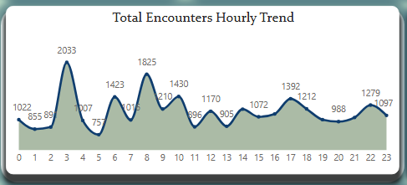
t
FINDINGS
What times of day and which encounter classes see the highest volume?
Ambulatory and urgent care cases rose up usually at 3 a.m. and early hours in the morning, this surge could indicate high overnight demand for non-scheduled, semi-urgent cases.
The data shows that the 3rd hr. mark to have the highest volume of 2,033 encounters, the 8th and 10th hr. follow closely with 1,825 and 1,423 encounters.
Encounter classes filtered at those hours showed ambulatory, outpatient, urgentcare and emergency to be the top

Slide 13
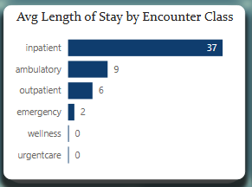
FINDINGS
Which encounter classes have the longest stays
Inpatient, ambulatory and outpatient encounters had the longest average length of stay, this highlights a higher resource use, treatment complexity and potential cost concentration
The data shows that Inpatient, ambulatory and outpatient classes, had the average longest length of stays, with 37, 9, 6 hours

Slide 14
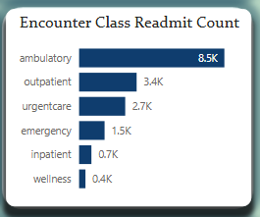
FINDINGS
Which encounter class has the most readmissions?
The high readmission volume in ambulatory care may point to gaps in follow-up or post-discharge management, signaling an area for quality improvement or cost reduction.
The data reveled that ambulatory class had the most readmission count of 8,500, followed closely by outpatient, urgentcare, and emergency at 3,400, 2,700 and 1,500 total cases respectively

Slide 15
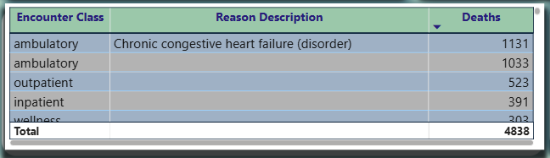
FINDINGS
Which encounter reasons account for most deaths?
High mortality in ambulatory cases suggests possible misclassification of critical or palliative patients and gaps in preventive or follow-up care.
Chronic congestive heart failure and cases with unclear reasons in ambulatory class accounted for most death, followed by outpatients also with no records .
A drill-down investigation of the unclear reasons showed, a description pattern of cardiac and mental health issues, end of life care and domestic abuse and fall risk cases

Slide 16
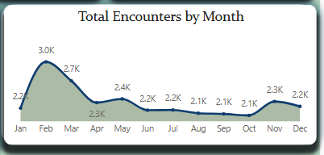
FINDINGS
How do encounters trend by year, month?
Seasonal spikes in early-year encounters (Feb–Mar) may reflect post-holiday health checkups, flu-related visits, or scheduled follow-ups, while the 2014 and 2021 peaks may tie to policy or pandemic-related factors.
The data showed that the:
Peak Month for patient encounters is in February and March, the trend remains relatively steady for the rest of the year.
Peak Year for patient encounters was in 2014 and 2021 in those months

Slide 17
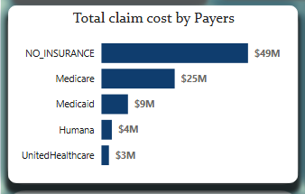
FINDINGS
Which insurers cover the largest share of costs?
The largest share of costs is covered by patients with no insurance; this shows a big coverage gaps and indicates systemic underinsurance and weak private payer support. Medicare’s strong share suggests it’s the most reliable payer
The data shows that the No Insurance category takes the top of large share of costs at 49M USD, followed by medicare, Medicaid at 25M & 9M USD respectively

Slide 18
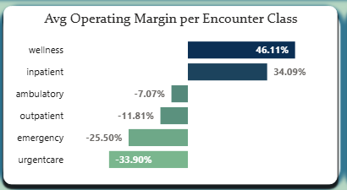
FINDINGS
Which encounter class generates most profits?
Results suggests that resource-intensive acute care services strain margins, while preventive and planned care remain financially sustainable.
The data revealed that wellness and inpatient classes generates good profit at 46.11% and 34.09%,
Urgent care class had a low profit return at a negative 33.90%, followed closely by emergency cases at -25.50%

Slide 19
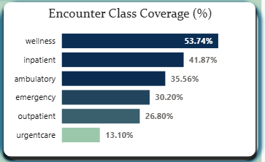
FINDINGS
What is the % of encounters Cost covered by Insurance
Coverage is focused on low-risk classes, while critical ones get minimal support — showing misaligned payer priorities and a need to shift coverage toward higher-risk, higher-readmission groups.
Wellness, inpatient, ambulatory, emerge top 3 of classes with a high-cost insurance coverage at 53.74%,41.87%, 35.56% respectively, with urgentcare at the bottom with 13.10%

Slide 20
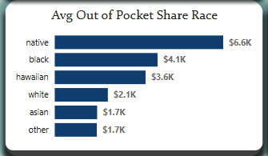
FINDINGS
Are out-of-pocket expenses higher for certain demographics?
Natives, blacks and Hawaiians, Pay more out of their pocket than other races
The data showed that Natives($6.6k), Blacks($4.1k) and Hawaiians($3.6k), pay more out of their pocket than other races

Slide 21
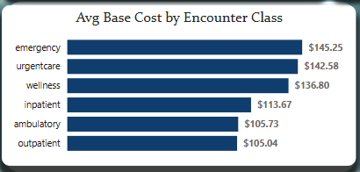
FINDINGS
Which encounter classes drive highest base cost
The high base cost classes suggests more intensive or specialized care are involved, while ambulatory and outpatient classes remain the most cost-efficient service categories.
The data shows that, Emergency($145.25), urgentcare($142.58), wellness classes($136.80), were the top 3, with close margin
Ambulatory($105.73) and Outpatient($105.73) class were the lowest in Cost price with close margins too.

Slide 22
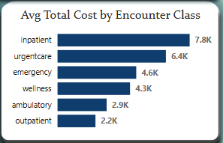
FINDINGS
Which encounter classes drive the highest costs?
The classes that drive the highest costs, is likely due to the intensive treatment, longer duration of care, and higher resource use required for these cases.
The data shows that the Inpatient($7.8k), urgent care($6.4k), emergency class($4.6k),turned out to be top 3 encounter class avg cost
Ambulatory($2.9k) and Outpatient($2.2k) Class had the lowest costs

Slide 23

INSIGHTS
Inpatient, ambulatory, and outpatient classes show prolonged stays, indicating inefficiencies in patient turnover and case management.
Inpatient, urgent care, and emergency classes drive the highest treatment costs, while urgent care and emergency generate low or negative profit margins.
Operational efficiency risks
Healthcare Quality Issues
Cost management issues
Coverage Gap & Access Inequities
High readmission and mortality rates in ambulatory and inpatient classes, with many deaths linked to unclear or misclassified encounter reasons.
Insurance coverage is concentrated in lower-risk classes, while high-risk groups and races like Natives, Blacks, and Hawaiians face higher out-of-pocket expenses.

Slide 24

RECOMMENDATIONS
Investigate deaths, long stays, and 3 a.m. encounter spikes in ambulatory care. Improve triage systems and strengthen follow-up care.
Focus on inpatient, urgent, and emergency encounters. Expand preventive care and better coordinate patient management to cut costs.
With only 36% insured, launch stronger enrollment drives, offer financial counseling, and renegotiate payer terms to close the gap.
Equity & Affordability Concerns Certain demographic groups face higher out-of-pocket (OOP) costs. Review billing and coverage structures to ensure fairness and affordability across all populations. Prioritize income- or needs-based relief programs.

Slide 25
RECOMMENDATIONS
5. Wellness and inpatient care have better coverage than emergency or urgent care. Advocate with payers for fair coverage across all classes.
6. Use the Affordable Care Act (ACA) and the Mental Health Parity and Addiction Equity Act (MHPAEA) to challenge under-coverage, especially for substance use disorder (SUD) and mental health (MH) services.
Next Steps :
Short term : audit care quality, start digital coverage report cards.
Mid term : expand insurance enrollment & wellness programs.
Long term : equity-driven financial model + integrated SUD/MH services.

Slide 26

CONCLUSION
Healthcare utilization and access will only improve when quality care delivery, efficient resource management, and fair insurance structures work in balance — supported by government policies that hold payers accountable for covering necessary costs as required by law.

Slide 27
The Data Immersed
TDI
2025
PowerBI Capstone Presentation
Thank
You
Your Feedback Is Appreciated

